Slide 1
AMIT AI & DS DIPLOMA project
Analyzing Starbucks Beverages: Are Your Favorite Drinks Healthy?

Slide 2
Team members:
1. Abd El Rahman
2. Rose Essam Ramzi
3. Mohammed Ahmed Mohammed Ahmed Onsi
4. Youssef Zein EL Abdein
Under the supervision of :
Eng. Abdalla

Slide 3
TABLE OF CONTENTS
01.
02.
03.
introduction
Problem Statement
Data Collection
04.
05.
06.
Management
Plan
Data Analysis & Dashboard
Model Training & Testing

Slide 4
01.
Intro.
Analyzing Starbucks Beverages:
Are Your Favorite Drinks Healthy?

Slide 5
problem STATEMENT
This dataset is for Starbucks beverages
Targeting the knowledge of whether the beverage is healthy or not !

Slide 6
02.
Problem Definition

Slide 7
What Problem Are We Solving?
Most people enjoy Starbucks drinks but ignore the nutrition label.
This project analyzes Starbucks beverage nutrition and classifies each as healthy or unhealthy.
Our goal is to help users make smarter choices

Slide 8
03.
Data Collection

Slide 9
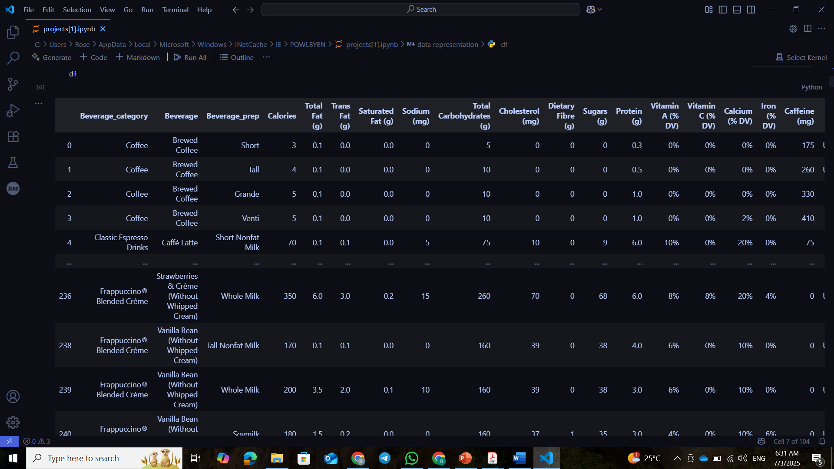
Where did we get the data
Source: Kaggle – Starbucks Beverage Nutrition Dataset
Source

Slide 10
04.
Data wrangling

Slide 11
Data cleaning is
Having unrelated columns
Duplicated data
Missing values
problem
Drop the unrelated columns
Drop Duplicated data
Handling Missing values
solution

Slide 12
05.
Data Analysis & visualization

Slide 13
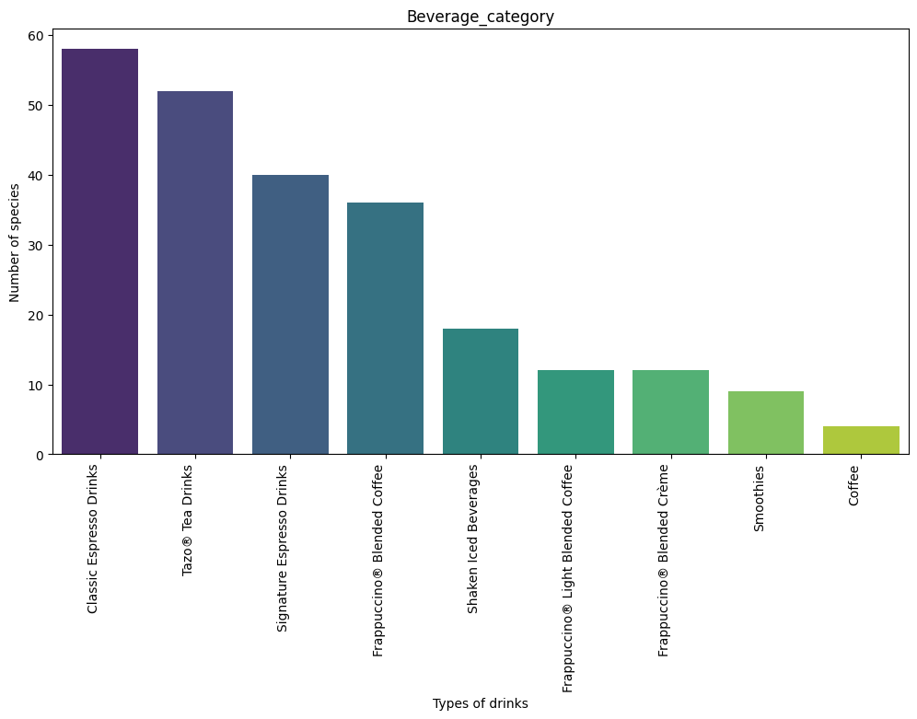
Data visualization
This barchart
is
Describing
the
beverage
category

Slide 14
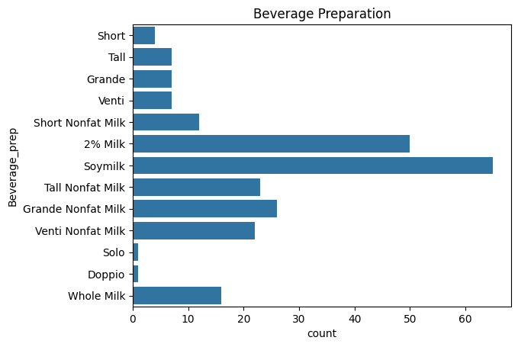
Data visualization
This chart is
Describing
the
beverage
Preparation

Slide 15
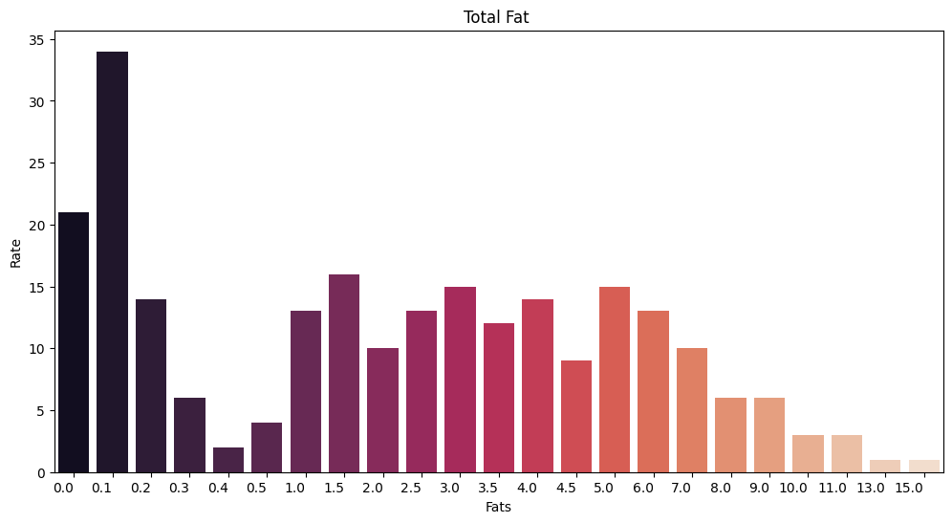
Data visualization
This
barchart is
Describing
the
Total fat
category

Slide 16
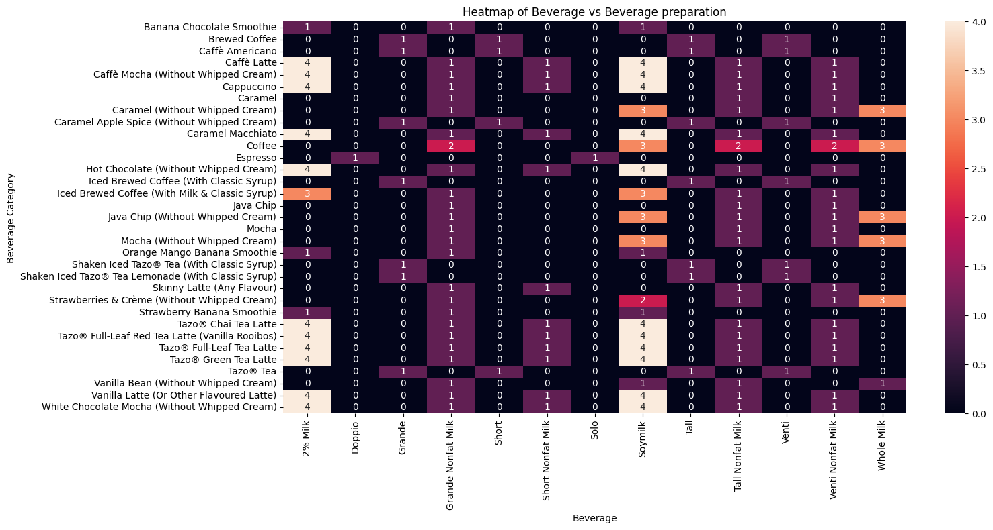
Data visualization
This
Heatmap
Is
describing
Beverage
category

Slide 17
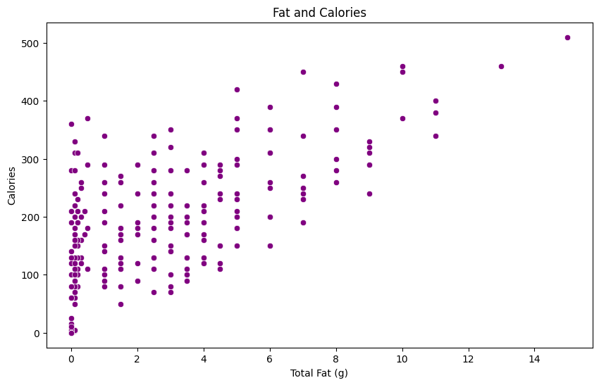
Data visualization
This
Scatter plot
Is to
describe
The total
fats & cals.

Slide 18
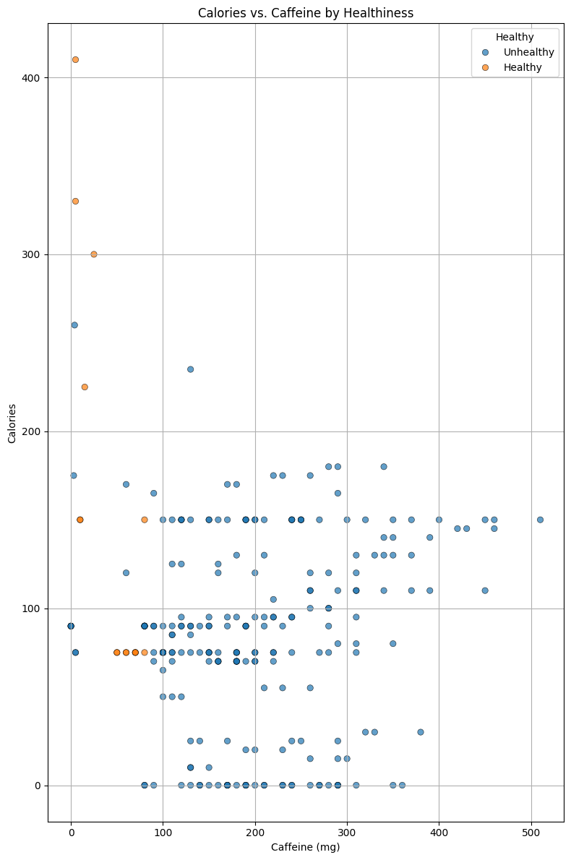
Data visualization
This
Chart shows
Whether the
Beverage is
Healthy or
Not ?

Slide 19
Data preprocessing..
0.6
Define feature X and target Y
Encoded categorical features (like drink type)
Scaled numerical values
(e.g., height 175 cm → 1.75 m)
Balanced dataset (to fix class imbalance)
Split data into 80% training and 20% testing sets

Slide 20
🎯 Goal: Prepare the data for
accurate and fair modeling.

Slide 21
0.7
Model Training & Testing

Slide 22
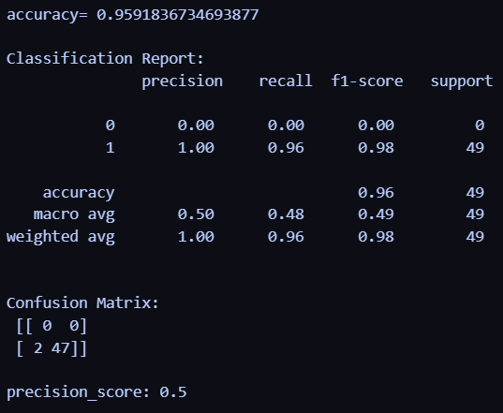
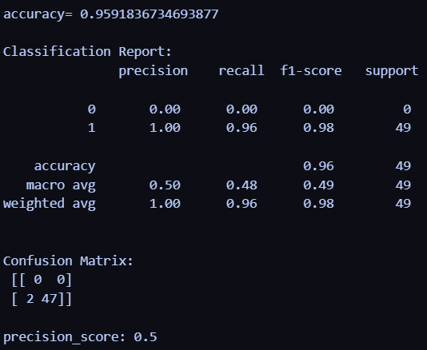
Logistic Regression
svc

Slide 23

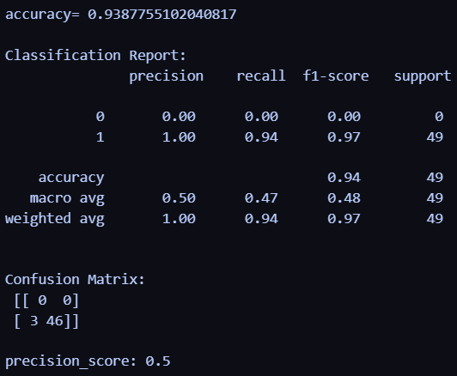
Linear svc
knn

Slide 24
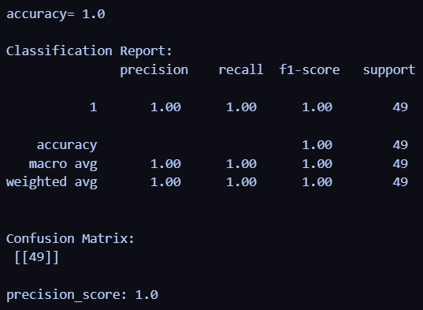
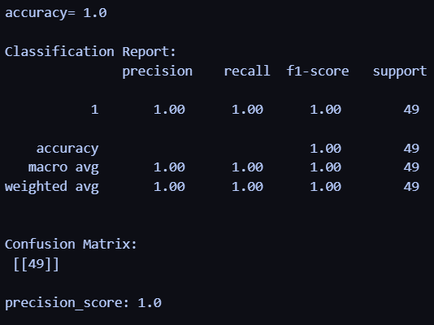
Decision Tree Classifier
Bagging Classifier

Slide 25
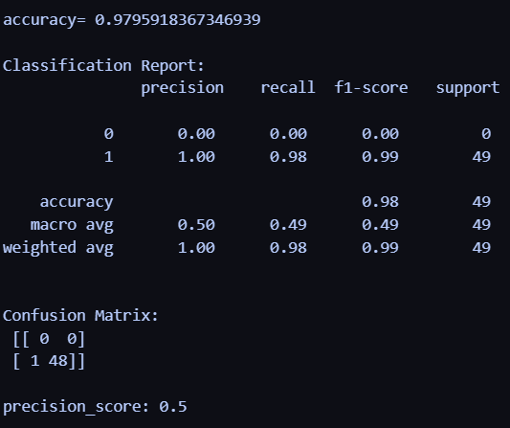
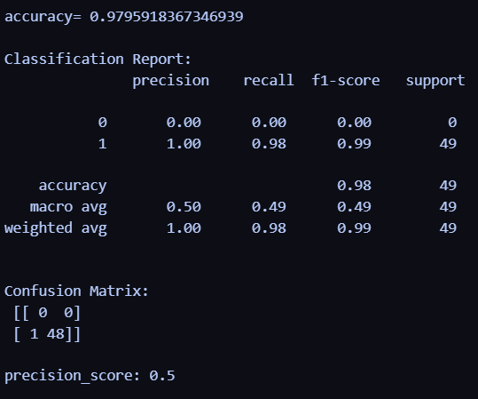
Random Forest Classifier
Extra Trees Classifier

Slide 26
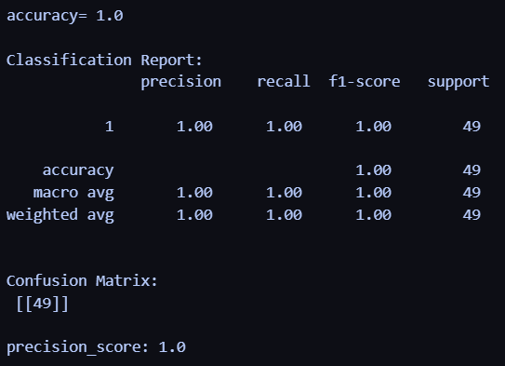
Voting Classifier

Slide 27
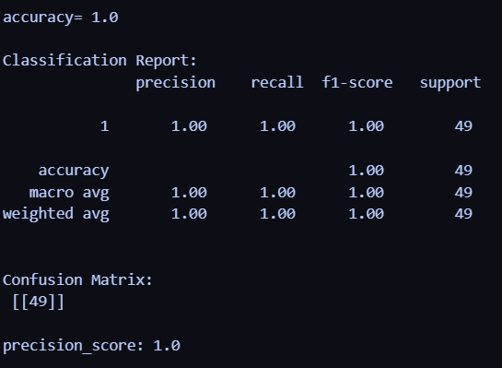
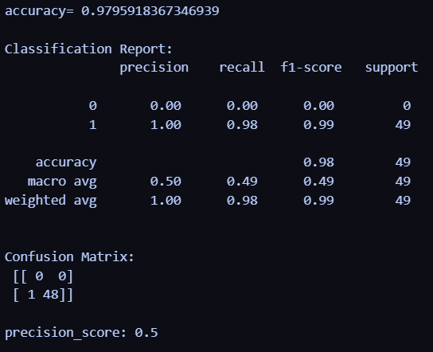
Stacking classifier
Xgb classifier

Slide 28
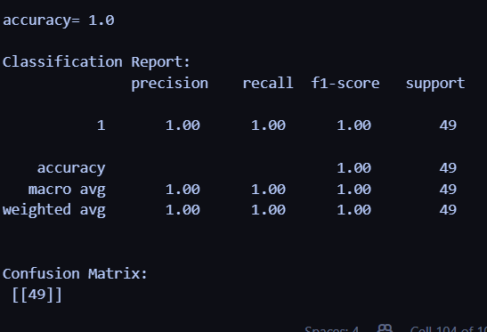
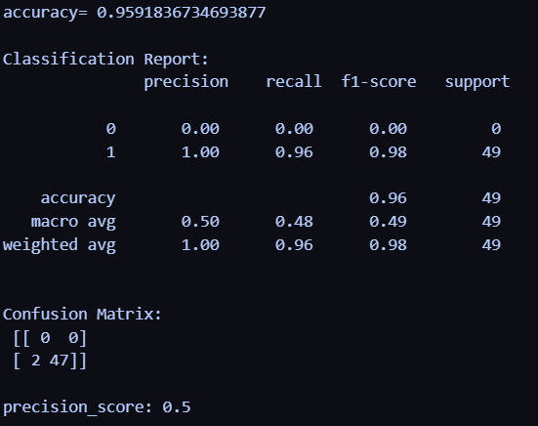
CatBoost Classifier
LGBM Classifier

Slide 29

Thank you ☺!

